Slide 1
Overflow Sensor for ELISA Plate Washer
Jenna Wen
August 12, 2019

Slide 2
CAD files, circuit diagrams, BOM, and SOP at:
https://github.com/jennaniwens/fiveprime2019-overflow_sensor

Slide 3
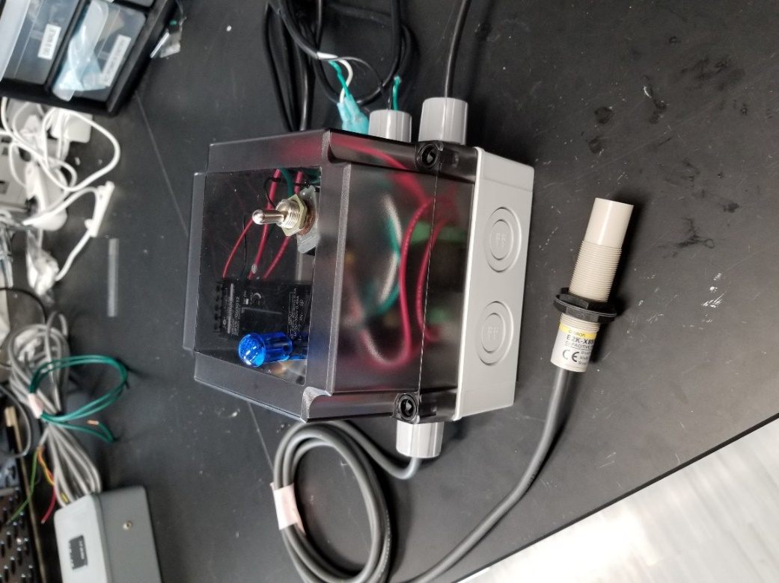
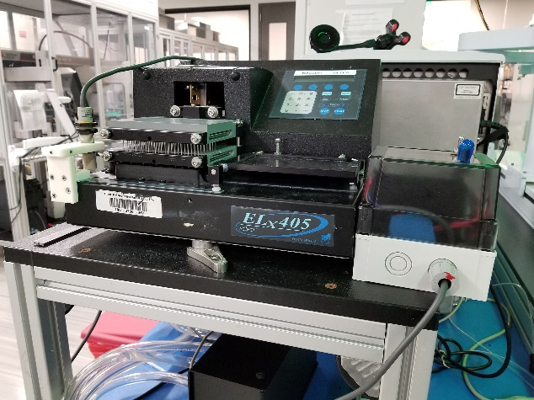
Overview
Added a feature to washing systems to detect liquid overflow and stop washer function
Plate washer with overflow sensor mounted
Overflow sensing module

Slide 4
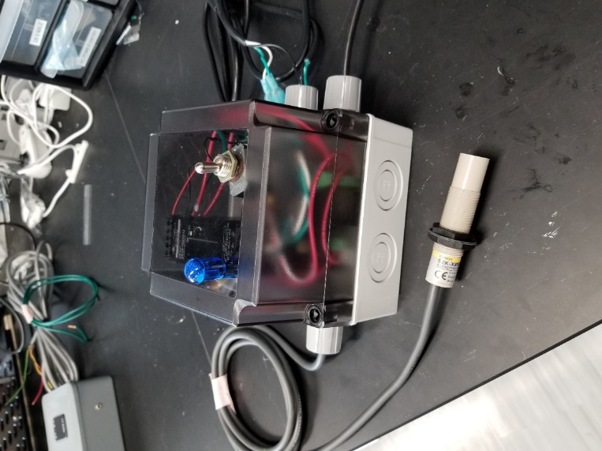
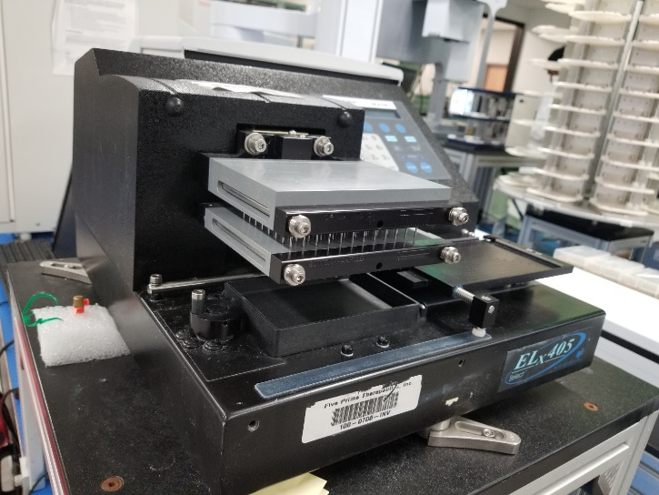
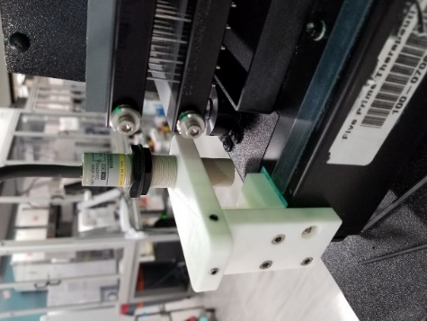
Purpose
ELISA plate washers can’t sense liquid spills
Notes:
Washer
- Possible interface point is circled

Slide 5
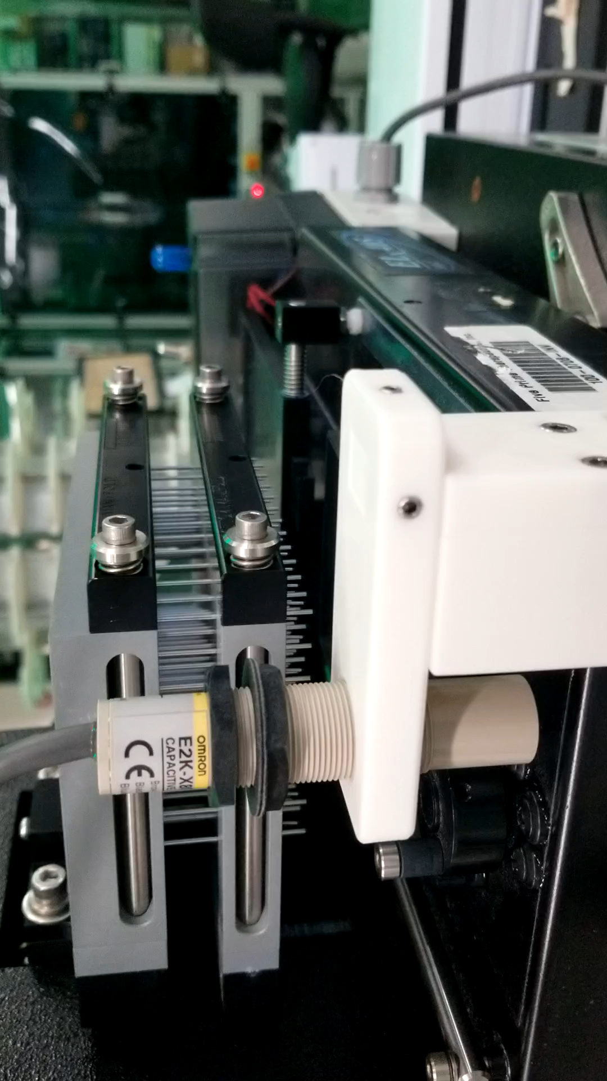
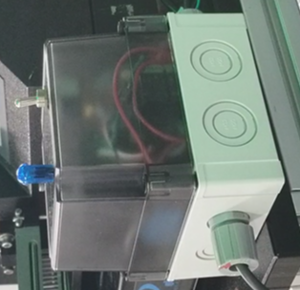
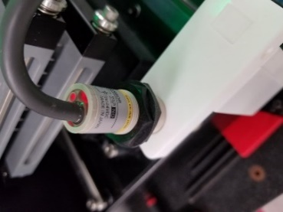
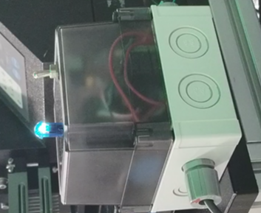
Overflow Sensing System
Washer is running
User cleans up spill and restarts washer
Spill occurs
Spill is detected
Washer is turned off

Slide 6
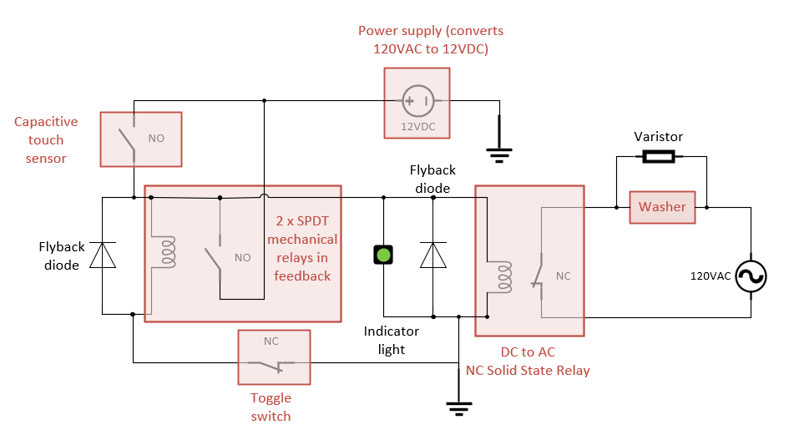
Sensing Circuit & Components
Capacitive sensor senses capacitive changes up to 8mm away
Varistor placed in parallel with washer to protect it from voltage spike after the machine is reset
Circuit design by Stephen Mehi
Flyback diode to dissipate voltage spikes from the relay
DC to AC Relay interface between sensing circuit and washer
Indicator light states
Light | Sensor State | Circuit State | Washer State
On | Tripped | Open | Off
Off | Actively Sensing | Closed | On

Slide 7
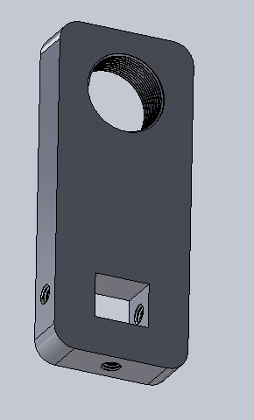
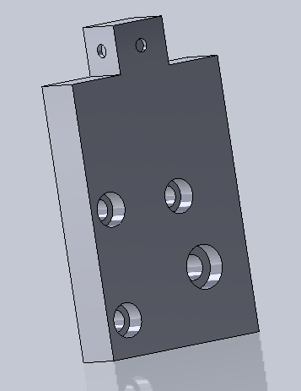
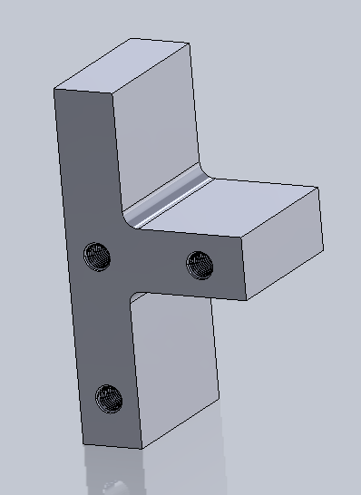

Sensor Mount Considerations
Did not want to drill a hole into plate washer (used existing hole)
Sturdy enough to hold sensor up even when not in use
Intuitive for user to remove and clean

Slide 8
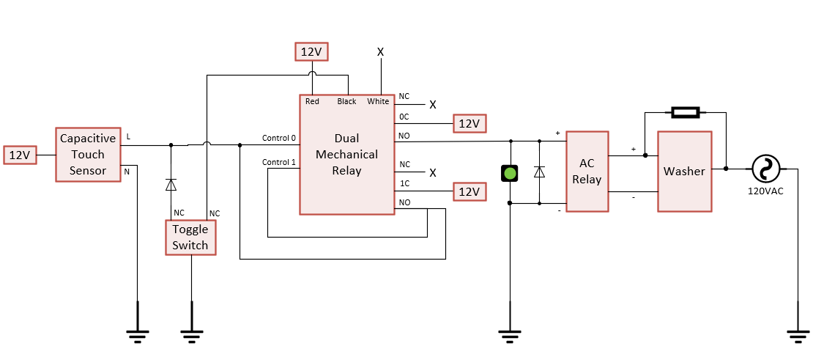
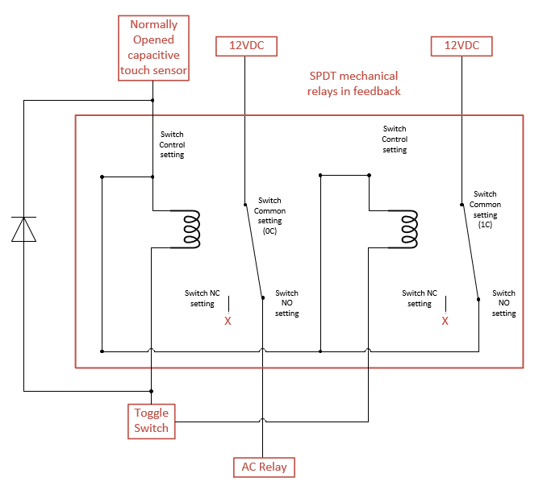

Things Learned from Overflow Sensor Project
Stephen Mehi
States table (switch etc)
Check Normally Open / Normally Closed states of components
Latching relay wiring
Translating circuit diagram to electrical component
Prototyping the sensor mount
Contacted external vendor for machining
SOP-writing
for resetting, cleaning, and switching out indicator light
Includes FAQs, wiring details
Indicator light states
Light | Sensor State | Circuit State | Washer State
On | Tripped | Open | Off
Off | Actively Sensing | Closed | On
Notes:
Normally open / normally closed
Operates like a switch that’s either open or closed, until it receives an impulse that causes the other switch state
Latch relay wiring
Actual part looks very different from how it’s supposed to be wired

